Slide 1
Sprint 6 Presentation
Mystery Game

Slide 2
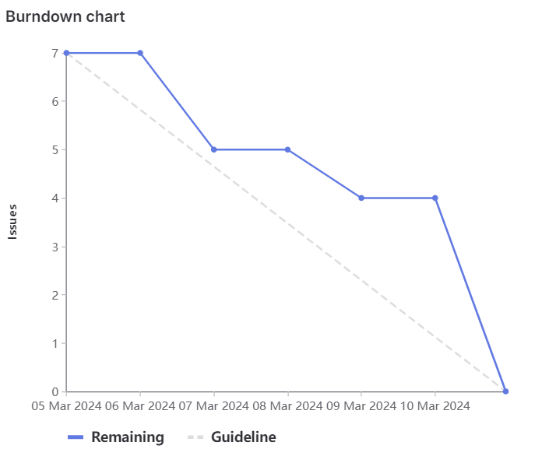
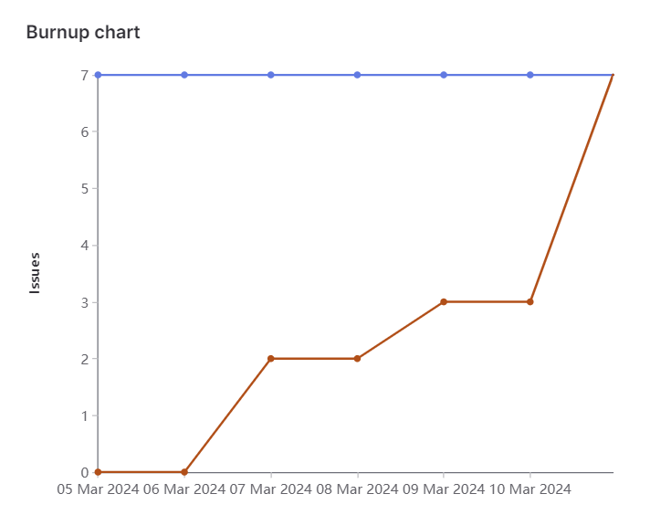
Milestone Burndown Chart

Slide 3
What worked well/What did not work well
The tickets/tasks were split well
Front-end and back-end implementations according to the design doc
Improvements:
Marking the ticket completed as soon as it’s done
Faster planning

Slide 4
Tehreem
Back end
Front end
Documentation
Total Weights: 14

Slide 5
Kalindu
Front End Implementation (Puzzle landing page + Puzzle redirect page)
Front End Styling
Quality Assurance and improvements
Total weight: 12

Slide 6
Cavaari
Front-End Implementation
Front End Styling
Quality Assurance and responsiveness
Total Weights: 12

Slide 7
Karina
Back-end game development
Front end visual components
Mystery cryptogram design
Total weights: 14

Slide 8
Egor
Back-end implementation
Mystery cryptogram design
Front end visual components help
Hiding pages logic
Total weights : 14

Slide 9
Muhammad
-Front end implementation, quality assurance
-Helped with design for logic and visual improvements
Total weights : 12

Slide 10
Eric
Back-end game development
Help with Mystery cryptogram design
Total weight: 12

